Slide 1
Important Concepts

Slide 2
Contents
Ensemble Techniques: Random Forest
Bagging, Boosting
Balanced and Imbalanced dataset

Slide 3
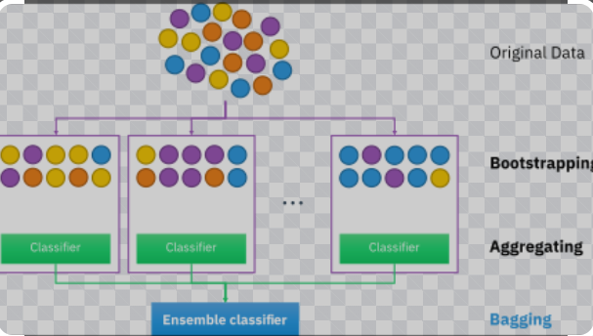
Bagging (Bootstrap Aggregation)
Row sampling with replacement

Slide 4
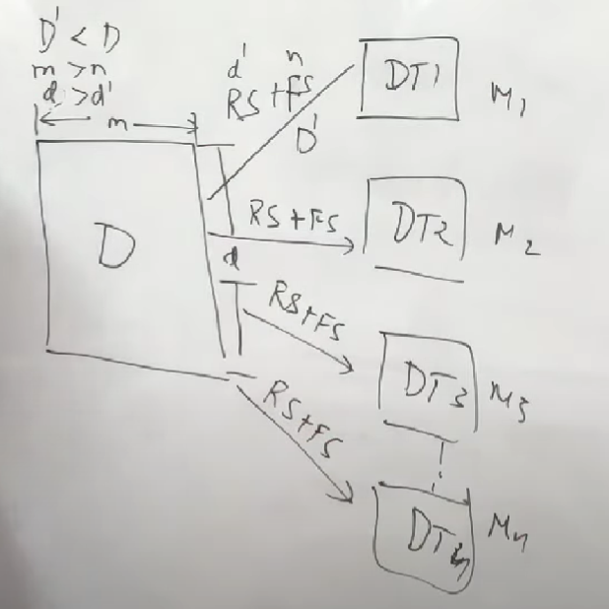
Random Forest : Example of Bagging
Row sampling + Feature sampling

Slide 5
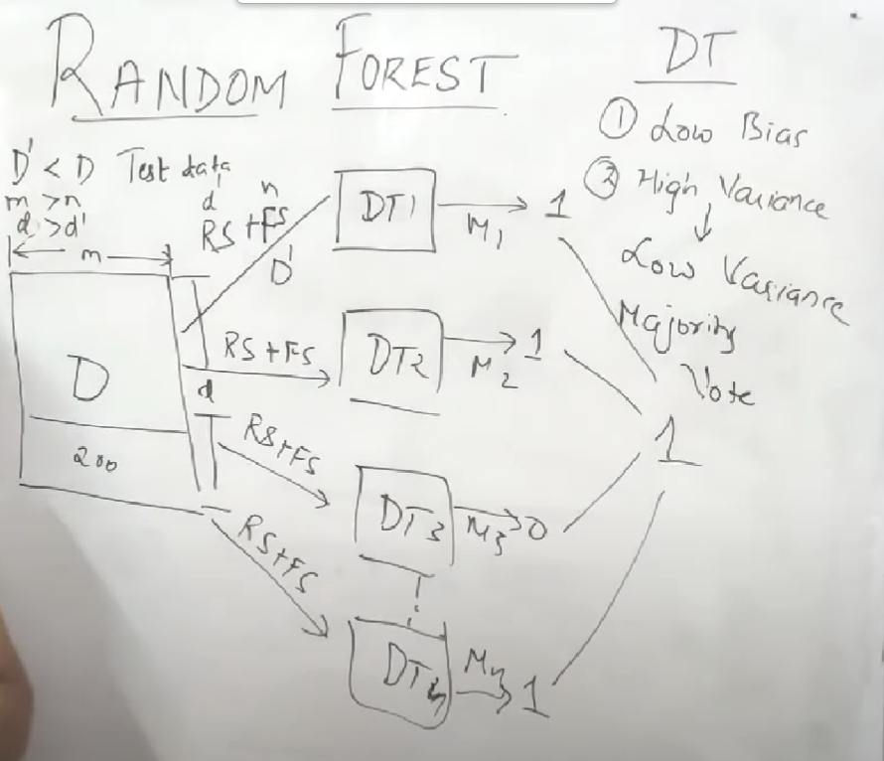
Now I get my test data and give to the model!

Slide 6
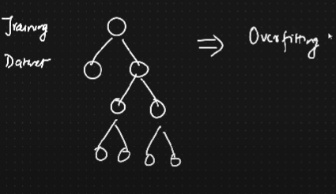
RANDOM FOREST: BAGGING (Classification+ Regression)
Training accuracy high but test accuracy low = OVERFIT ( Low bias, high variance)

Slide 7
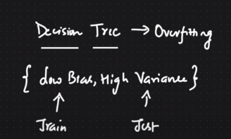
RANDOM FOREST converts high variance.>low variance

Slide 8
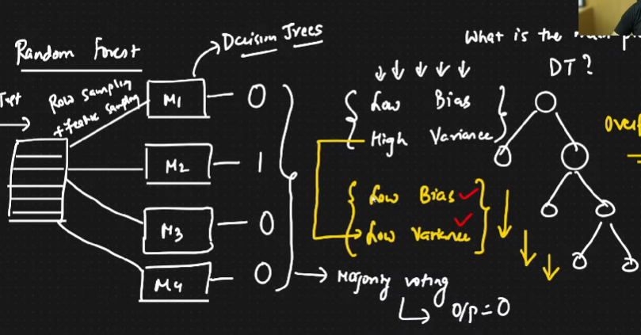
Random Forest Classifier

Slide 9
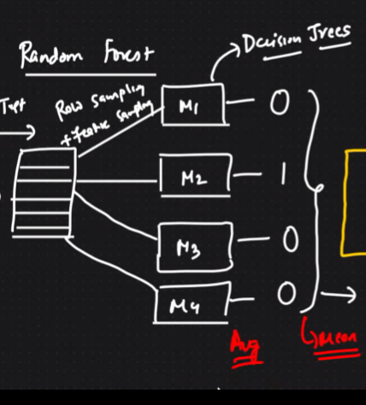
Random Forest Regressor

Slide 10
Is standardization/normalization required?
No
Is RF impacted by the outliers?
No

Slide 11
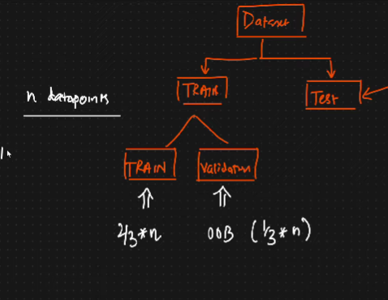
OOB Score (Out of Bag Score)
Accuracy of training and testing dataset = OOB Score

Slide 12
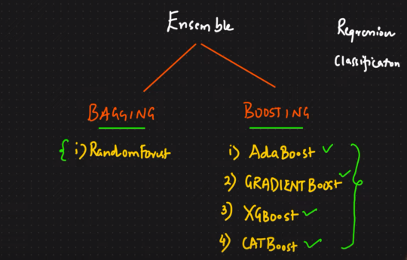
Ensemble Techniques

Slide 13
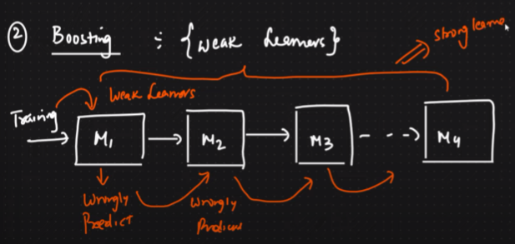
BOOSTING
Weak Learners are used here.

Slide 14
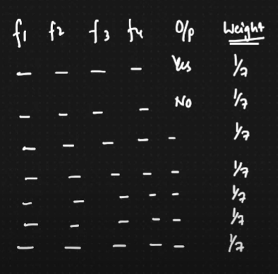
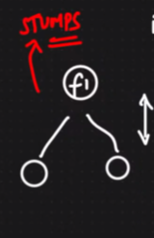
BOOSTING: AdaBoost
STUMPS= weak learner, one level depth decision tree

Slide 15
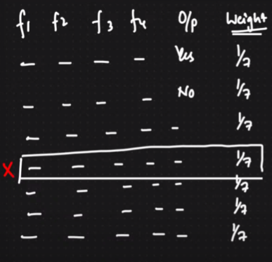
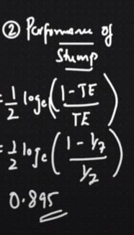
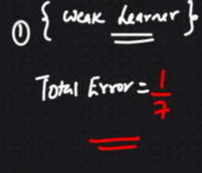
BOOSTING: AdaBoost
Total error, Stump performance

Slide 16
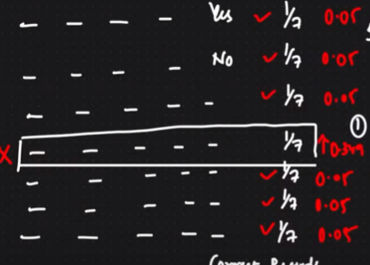
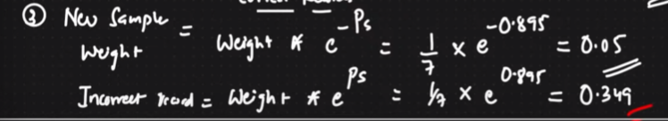
BOOSTING: AdaBoost
Updating the weights: for right records, the weights should decrease and for wrong ones, increase

Slide 17
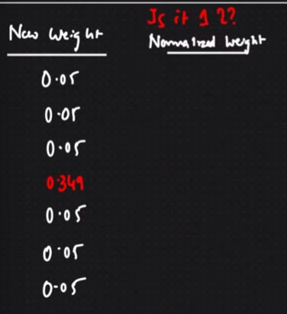
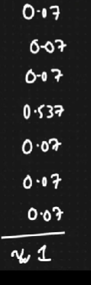
BOOSTING: New weights (Is the overall sum =1?)
Normalization? How?

Slide 18
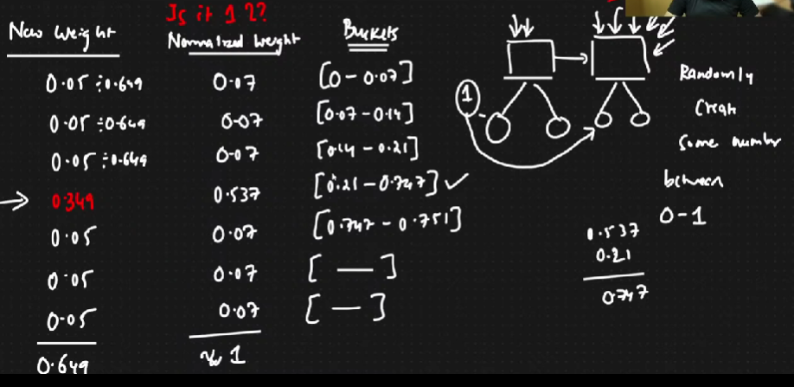
BOOSTING: New weights (Is the overall sum =1?)

Slide 19
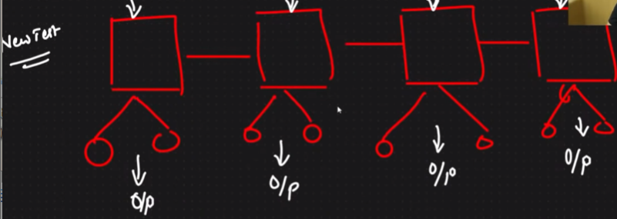
BOOSTING: New weights (Is the overall sum =1?)

Slide 20
Ensemble Techniques

Slide 21
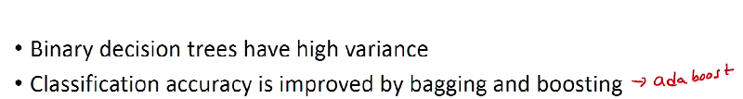
GRADIENT BOOSTING
(sequential tree)
https://en.wikipedia.org/wiki/Gradient_boosting

Slide 22
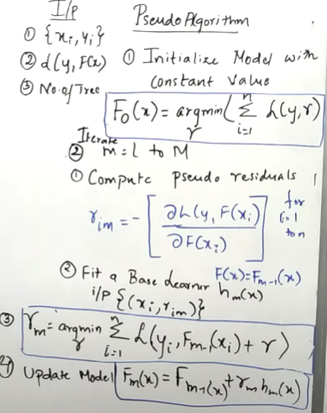
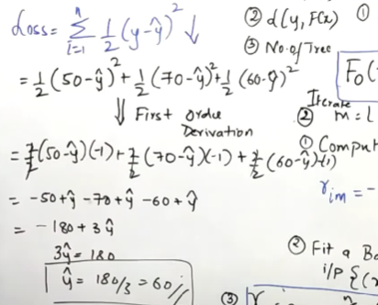
GRADIENT BOOSTING
(sequential tree)
https://en.wikipedia.org/wiki/Gradient_boosting

Slide 23
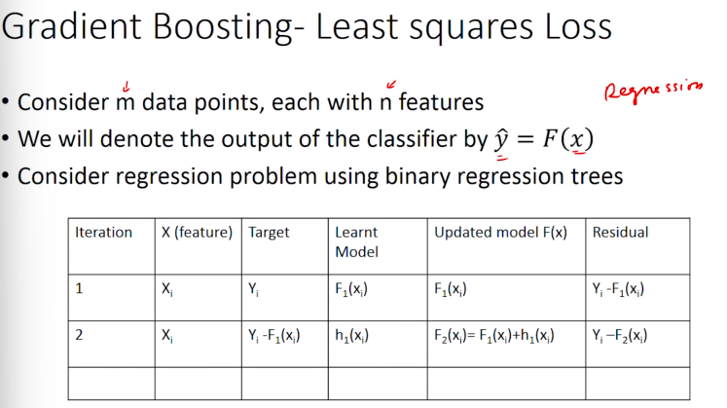

Slide 24
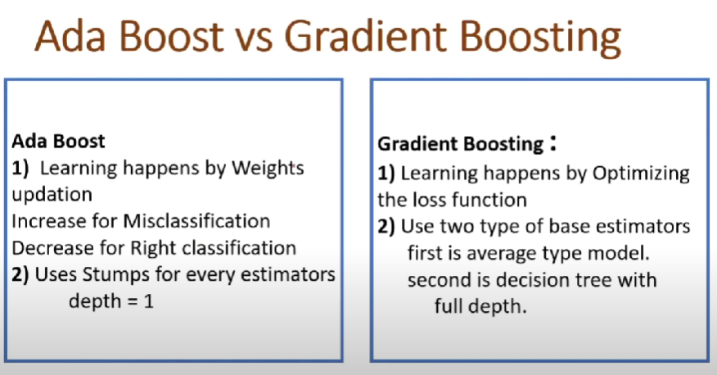

Slide 25
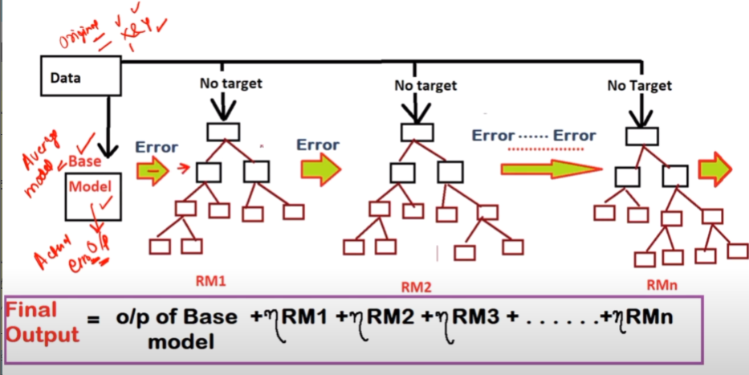

Slide 26
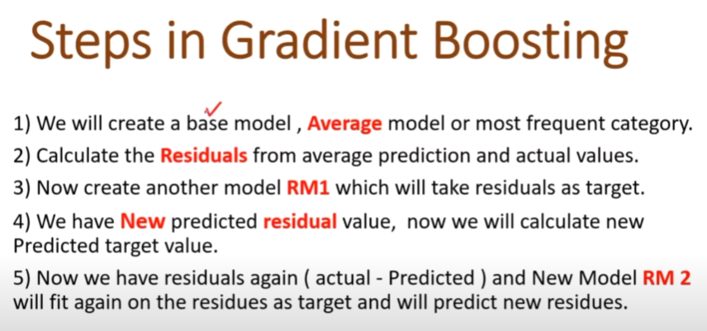

Slide 27
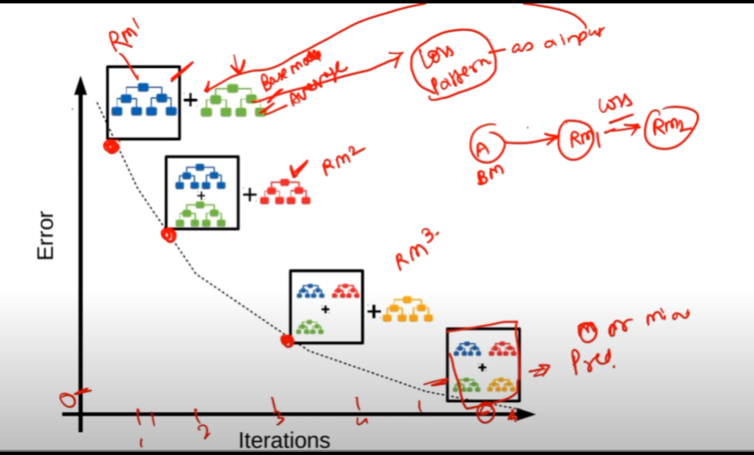
Gradient Boosting

Slide 28
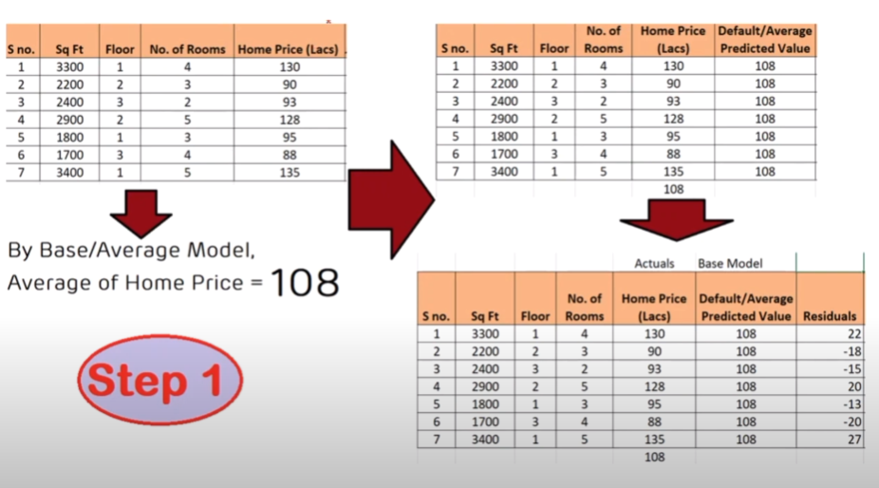

Slide 29
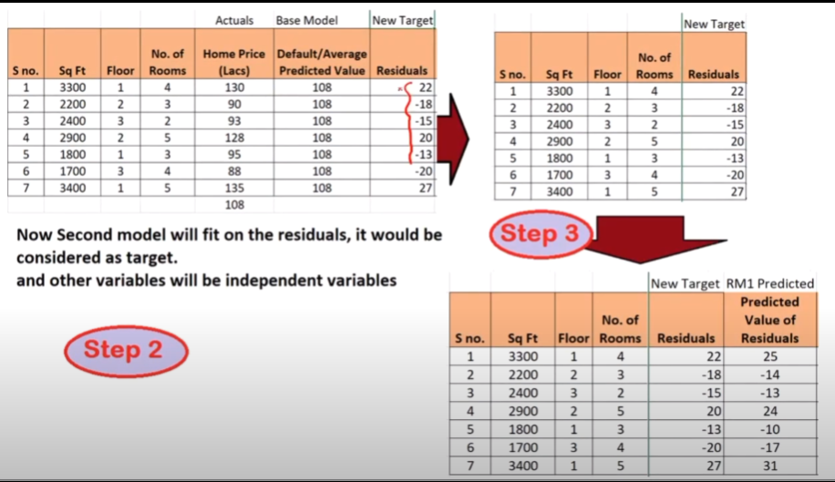

Slide 30
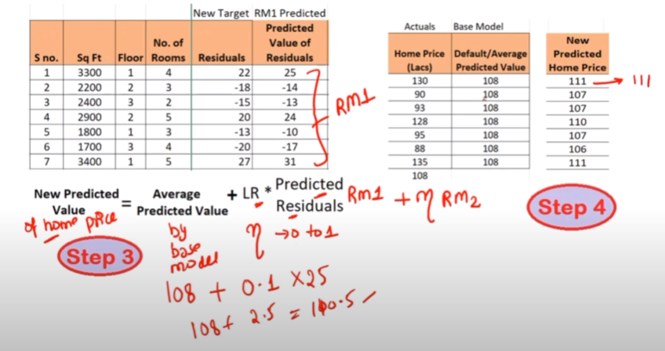

Slide 31
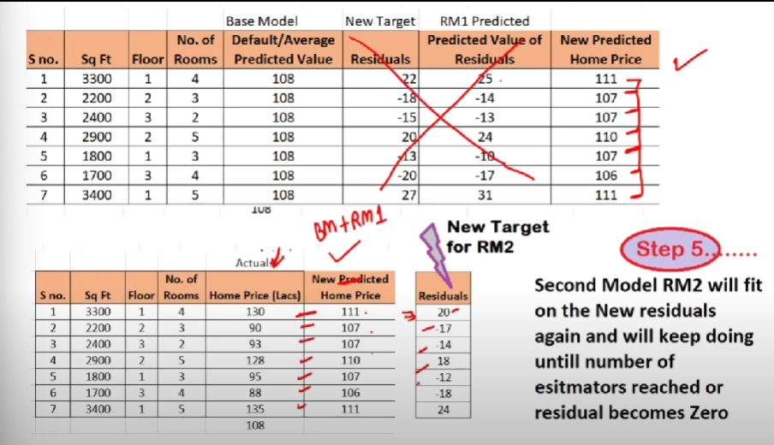

Slide 32
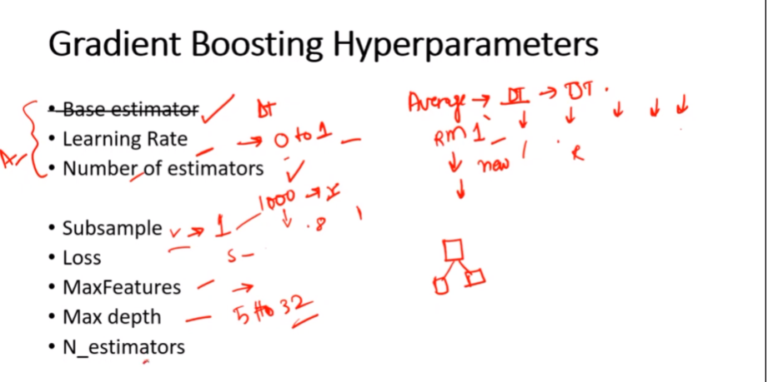

Slide 33
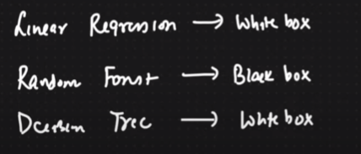
Black Box and White Box Model

Slide 34
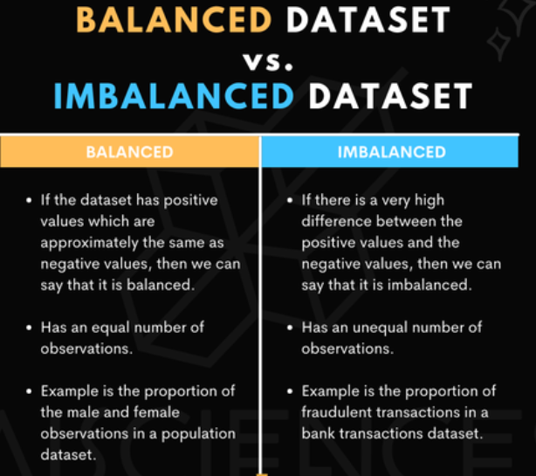

Slide 35
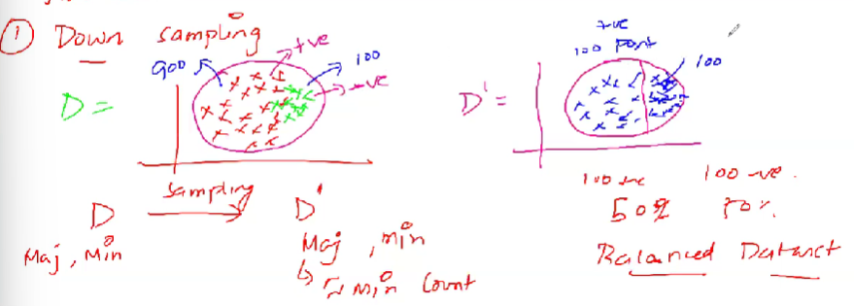
Ways to handle imbalanced dataset
DOWNSAMPLING
Minority remains same, majority becomes ~ minority

Slide 36
Disadvantages
Might be losing some critical information

Slide 37
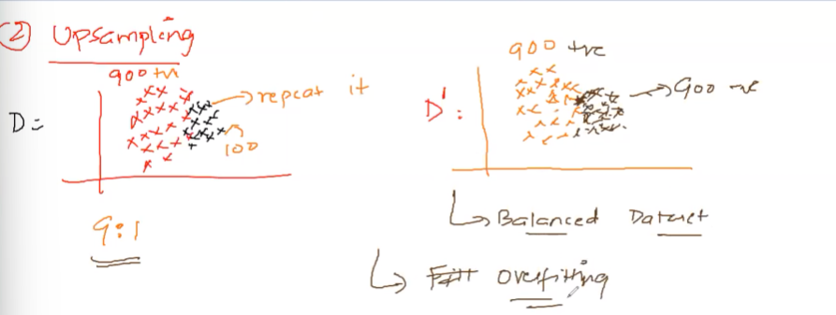
UPSAMPLING
Majority remains same, minority is repeated accordingly

Slide 38
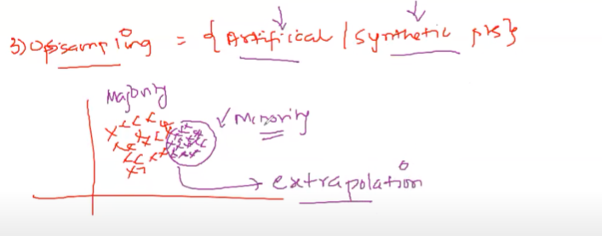
UPSAMPLING: Another rarely used method (Synthetic points, extrapolation)

Slide 39
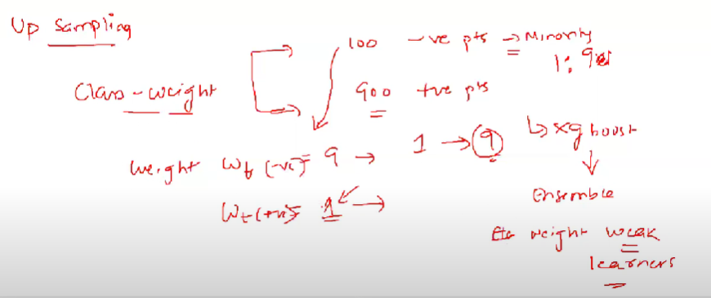
UPSAMPLING: Class-Weight

Slide 40
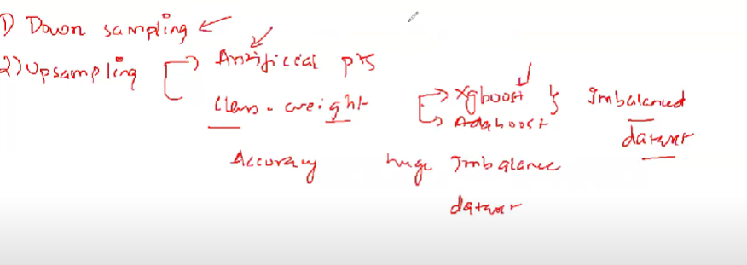
Downsampling over Upsampling?? Yes or No??

